Slide 1


EXPLORATORY PROJECT

Slide 2

Dynamic Functional Connectivity Analysis in fMRI for Autism Diagnostic Classification Using Machine Learning
SUPERVISOR :Jac Fredo Agastinose Ronickom
SPECIAL THANKS : Phd Scholar Chetan Rakshe

Slide 3
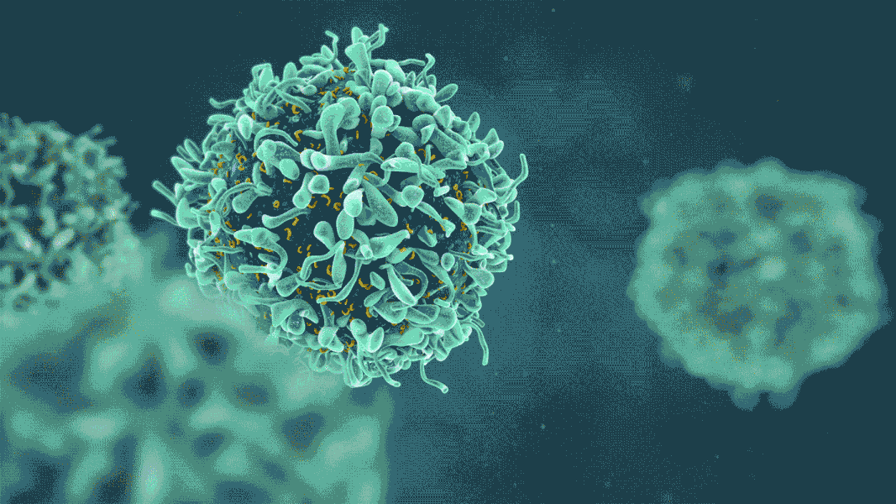
WEEKLY UPDATES
WEEK
Research upon ML and Supervised ML Algorithims
Built Java Programs to Process the data and find Pearson Correlation Matrix
Built the same program in Python and also showed Data Heatmaps
Extracted the Lower Triangular Matrix and Ranked the Features
Applied Various ML Algorithims on them to find the best ML Model
Further Processing for better Results
Manipulation of Results
MORE SPACE FOR DIRECT CONTACT

Slide 4

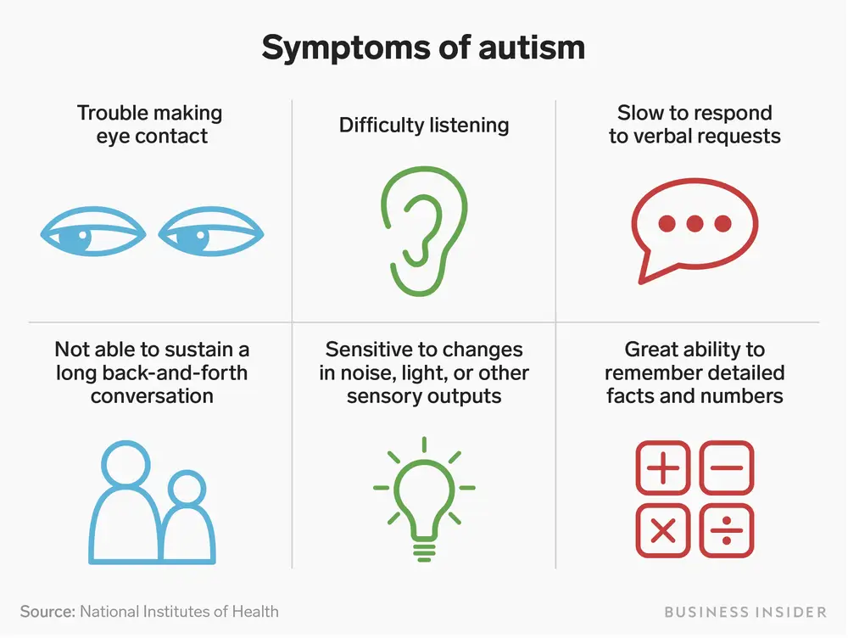
Autism spectrum disorder (ASD) is a neurological and developmental disorder that affects how people interact with others, communicate, learn, and behave. Although autism can be diagnosed at any age, it is described as a “developmental disorder” because symptoms generally appear in the first 2 years of life.

Slide 5
Machine learning (ML) is a field of study in artificial intelligence concerned with the development and study of statistical algorithms that can effectively generalize and thus perform tasks without explicit instructions.
MACHINE LEARNING
SUPERVISED ML
For every x there is a y
UNSUPERVISED ML
Clustering of X without Y
SEMISUPERVISED
Small Labeled and large Unlabeled
REINFORCEMENT ML
Learn from Experience
www.yourwebsite.com

Slide 6




SUPERVISED ML
SVM(LINEAR,RBF,SIGMOID)
RANDOM FOREST
Support Vector Machine (SVM) is a powerful machine learning algorithm used for linear or nonlinear classification, regression, and even outlier detection tasks. SVMs can be used for a variety of tasks, such as text classification, image classification, spam detection, handwriting identification, gene expression analysis, face detection, and anomaly detection..
Random forest is a commonly-used machine learning algorithm trademarked by Leo Breiman and Adele Cutler, which combines the output of multiple decision trees to reach a single result. .
LOGISTIC REGRESSION
KNN
Logistic regression is a process of modeling the probability of a discrete outcome given an input variable. The most common logistic regression models a binary outcome; something that can take two values such as true/false, yes/no, and so on.
The k-nearest neighbors algorithm, also known as KNN or k-NN, is a non-parametric, supervised learning classifier, which uses proximity to make classifications or predictions about the grouping of an individual data point.

Slide 7
SUPERVISED ML
MLP
XGBOOST
A multilayer perceptron (MLP) is a misnomer for a modern feedforward artificial neural network, consisting of fully connected neurons with a nonlinear kind of activation function, organized in at least three layers, notable for being able to distinguish data that is not linearly separable.
XGBoost is an optimized distributed gradient boosting library designed for efficient and scalable training of machine learning models. It is an ensemble learning method that combines the predictions of multiple weak models to produce a stronger prediction.

Slide 8
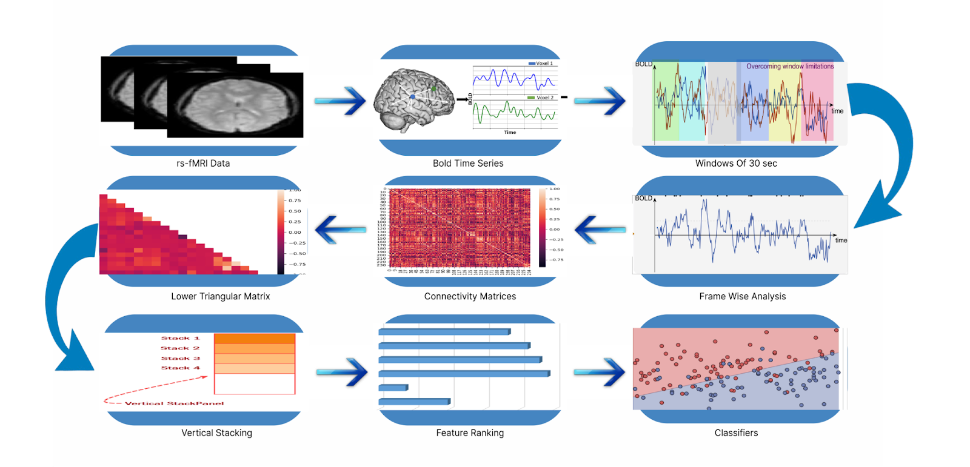
Process Pipeline
Data in csv files
Got the data successfully in a rar file format and then I Extracted it and got the final data in the form of CSV Files

Slide 9
Method
5 Model Evaluation:
The top 500 ranked features were used to train and evaluate various machine learning classifiers, including support vector machine (SVM), random forest, logistic regression, k-nearest neighbor, XGBoost, and multi layer perceptron. The performance of the classifiers was evaluated using five-fold cross-validation, and accuracy, sensitivity, specificity, precision, and f1 score were computed. The SVM classifier with a radial basis function kernel achieved the highest average classification accuracy of 97.77%.
1 Data Acquisition:
fMRI data was obtained from the Autism Brain Imaging Data Exchange (ABIDE) database, focusing on data from from the ABIDE databases for112 individuals (57 TD and 55 ASD)..
2 Data Preprocessing:
4 Feature Ranking:
Time series data was extracted from the fMRI data based on blood-oxygen-level-dependent (BOLD) signals from 236 regions of interest (ROIs) across cortical, subcortical, and cerebellar areas..
Features were ranked using the XGBoost method.
3 Feature Extraction:
To expand the dataset, time series data was divided into six windows of 30 seconds each, resulting in a total of 672 samples. Pearson correlations were computed between the ROIs from each 30-second window, generating 236x236 matrices. The upper/lower triangular portion of these matrices was used to create 27,230 features for each sample.

Slide 10
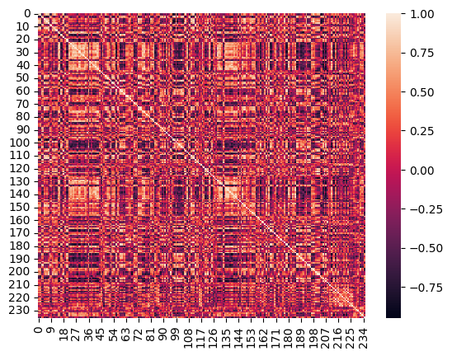
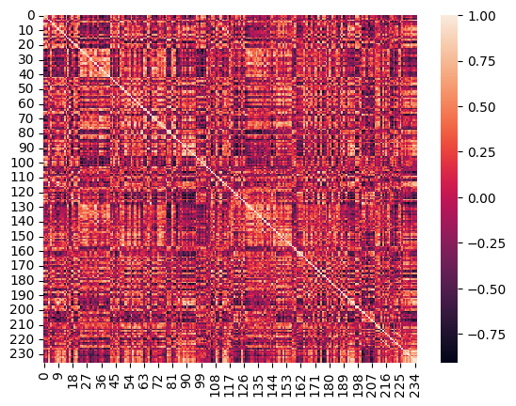
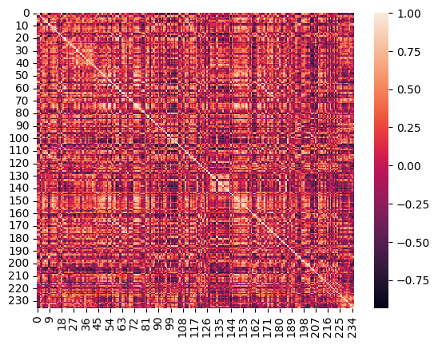
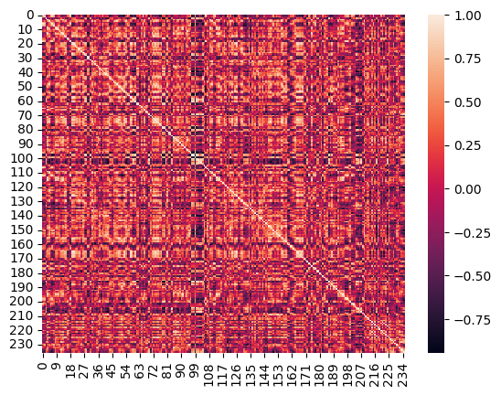
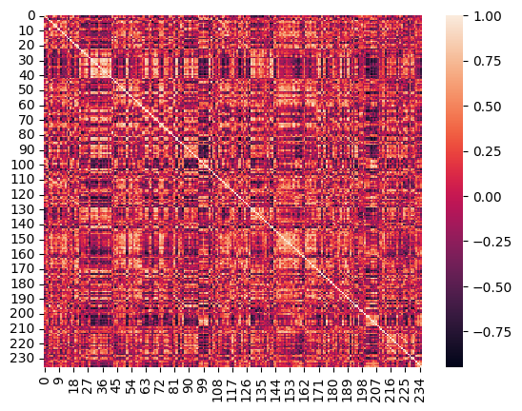
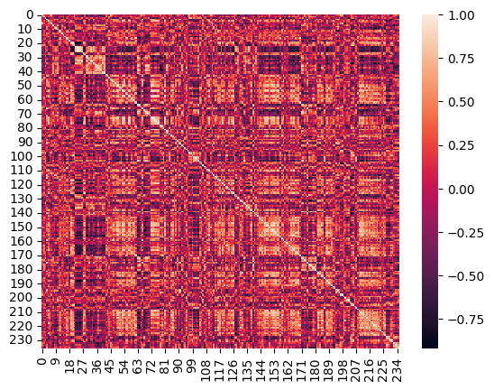
NOTE: This one can be edited down to 4 points if need be. Just simply select the text and boxes associated with that point and delete & rearrange if necessary.
NOTE: If you need more than 5 points, it would be easiest to include them on another page. Just duplicate this page and use it for additional points.
Results
HEAT MAPS FOR PIERSO CORELATION MATRICES
FOR TD SUBJECT
0-30
30-60
60-90 AND
90-120
120-150
150-180
This is where your subtext can go. It’s for demonstration purposes to show you what the text would look like.
This is where your subtext can go. It’s for demonstration purposes to show you what the text would look like.
This is where your subtext can go. It’s for demonstration purposes to show you what the text would look like.
This is where your subtext can go. It’s for demonstration purposes to show you what the text would look like.
This is where your subtext can go. It’s for demonstration purposes to show you what the text would look like.

Slide 11
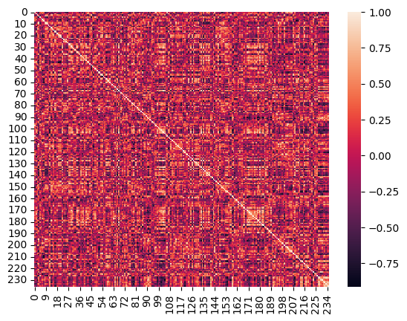
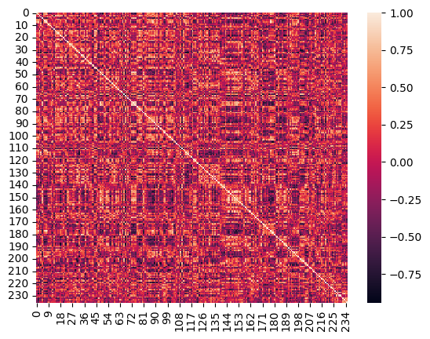
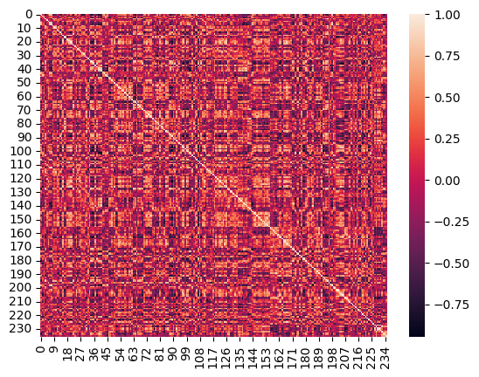
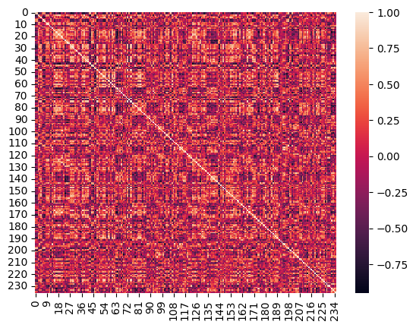
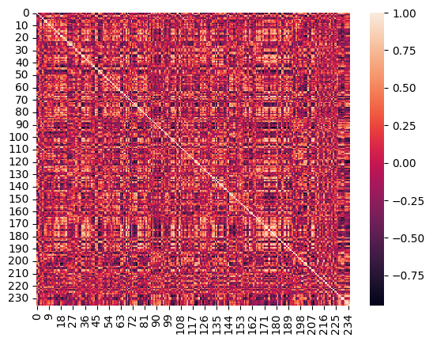
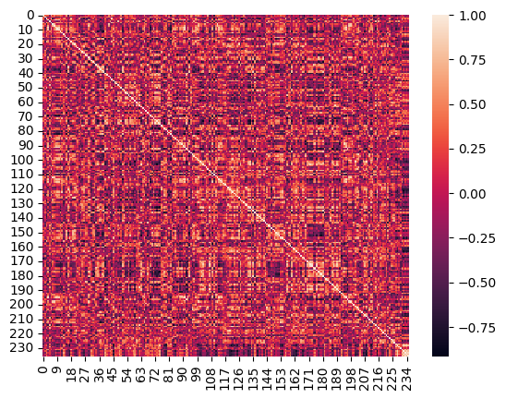
NOTE: This one can be edited down to 4 points if need be. Just simply select the text and boxes associated with that point and delete & rearrange if necessary.
NOTE: If you need more than 5 points, it would be easiest to include them on another page. Just duplicate this page and use it for additional points.
Results
HEAT MAPS FOR PIERSO CORELATION MATRICES
FOR AUTISM SUBJECT
0-30
30-60
60-90 AND
90-120
120-150
150-180
This is where your subtext can go. It’s for demonstration purposes to show you what the text would look like.
This is where your subtext can go. It’s for demonstration purposes to show you what the text would look like.
This is where your subtext can go. It’s for demonstration purposes to show you what the text would look like.
This is where your subtext can go. It’s for demonstration purposes to show you what the text would look like.
This is where your subtext can go. It’s for demonstration purposes to show you what the text would look like.
(a) | (b) | (c)
(d) | (e) | (f)
seconds, (f) 150-180 seconds.

Slide 12
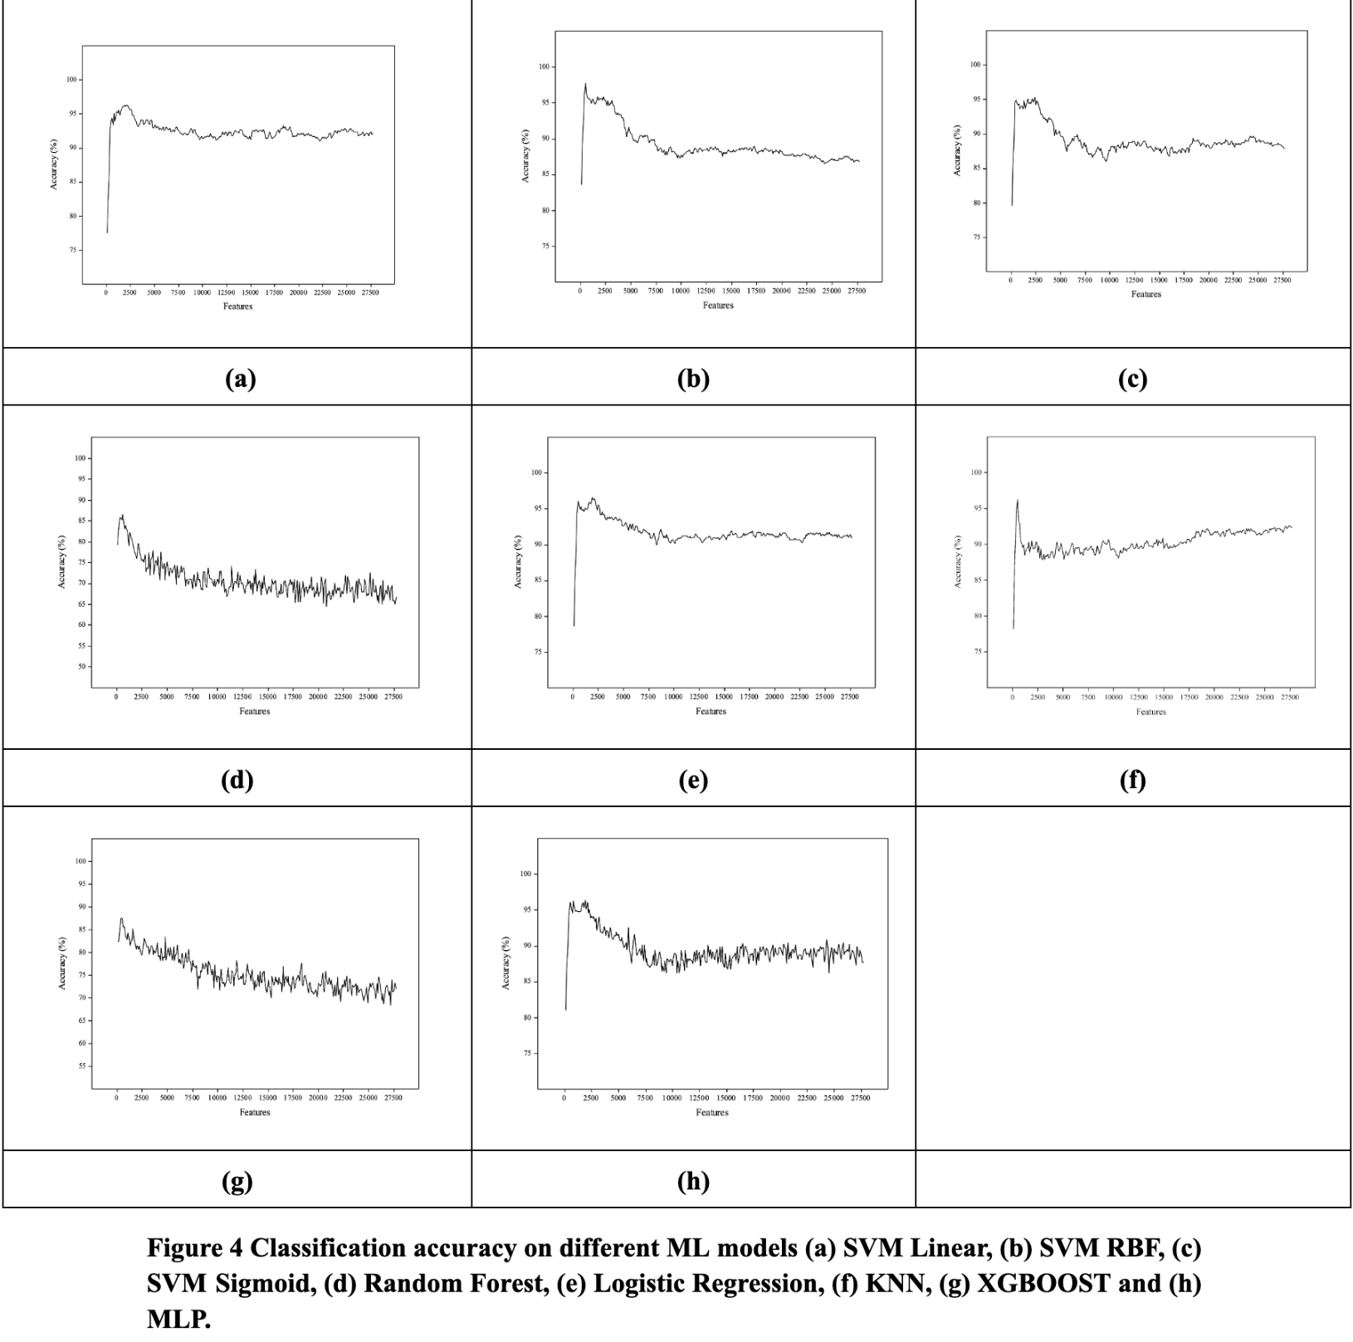

Slide 13
NUMBER OF FEATURES
Used top 1900 features
NUMBER OF FEATURES
Used top 500 features
NUMBER OF FEATURES
Used top 500 features
NUMBER OF FEATURES
Used top 2100 features
97.77
96.65
96.27
96.28
TOP 4 ACCURACY SCORES GIVEN BY PREDICTION MODELS.
RESULTS
SVM RBF
LOGISTIC REGRESSION
KNN
SVM LINEAR

Slide 14
CONCLUSION
A
B
Autism Spectrum Disorder (ASD) is a complex neurodevelopmental disorder characterized by social communication and behavioural challenges.
D
Dynamic functional connectivity (FC) is a measure of how the brain's functional networks change over time.
C
B
C
D
This study used fMRI and FC to investigate the brain networks in individuals with ASD and typically developing (TD) individuals
The study found that dynamic FC can be used to accurately classify individuals with ASD, with an accuracy of 97.77% using a support vector machine classifier.
A

Slide 15
Thank you

